Slide 1
Chapter 8
Fundamentals of Capital Budgeting

Slide 2
Chapter Outline
8.1 Forecasting Earnings
8.2 Determining Free Cash Flow and NPV
8.3 Choosing Among Alternatives
8.4 Further Adjustments to Free Cash Flow
8.5 Analyzing the Project

Slide 3
8.1 Forecasting Earnings
Capital Budget
Lists the investments that a company plans to undertake
Capital Budgeting
Process used to analyze alternate investments and decide which ones to accept
Incremental Earnings
The amount by which the firm’s earnings are expected to change as a result of the investment decision

Slide 4
Revenue and Cost Estimates
Example
Linksys has completed a $300,000 feasibility study to assess the attractiveness of a new product, HomeNet. The project has an estimated life of four years.
Revenue Estimates
Sales = 100,000 units/year
Per Unit Price = $260

Slide 5
Revenue and Cost Estimates (cont'd)
Example
Cost Estimates
Up-Front R&D = $15,000,000
Up-Front New Equipment = $7,500,000
Expected life of the new equipment is five years.
Housed in existing lab
Annual Overhead = $2,800,000
Per Unit Cost = $110

Slide 6
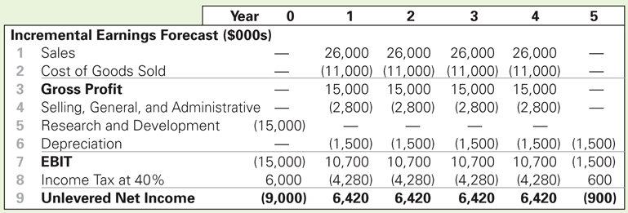
Incremental Earnings Forecast
Table 8.1 Spreadsheet HomeNet’s Incremental Earnings Forecast

Slide 7
Capital Expenditures and Depreciation
The $7.5 million in new equipment is a cash expense, but it is not directly listed as an expense when calculating earnings. Instead, the firm deducts a fraction of the cost of these items each year as depreciation.
Straight Line Depreciation
The asset’s cost is divided equally over its life.
Annual Depreciation = $7.5 million ÷ 5 years = $1.5 million/year

Slide 8
Interest Expense
In capital budgeting decisions, interest expense is typically not included. The rationale is that the project should be judged on its own, not on how it will be financed.

Slide 9
Taxes
Marginal Corporate Tax Rate
The tax rate on the marginal or incremental dollar of pre-tax income. Note: A negative tax is equal to a tax credit.

Slide 10
Taxes (cont'd)
Unlevered Net Income Calculation

Slide 11
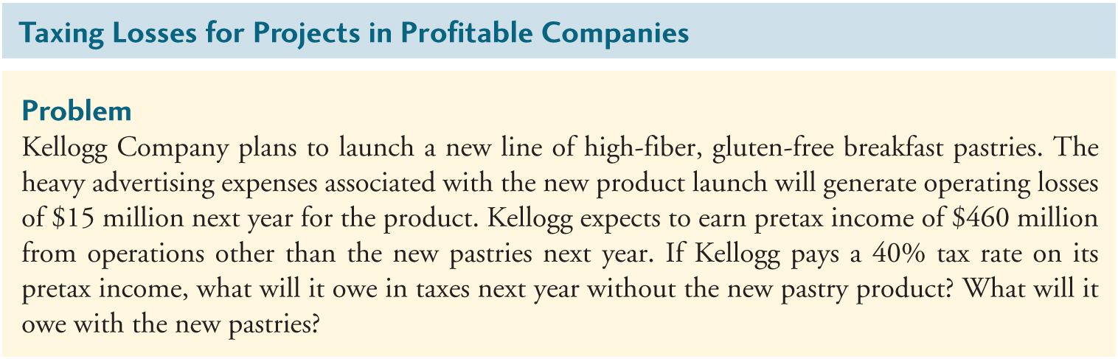
Textbook Example 8.1

Slide 12
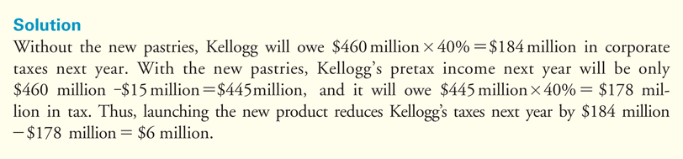
Textbook Example 8.1 (cont'd)

Slide 13
Indirect Effects on Incremental Earnings
Opportunity Cost
The value a resource could have provided in its best alternative use
In the HomeNet project example, space will be required for the investment. Even though the equipment will be housed in an existing lab, the opportunity cost of not using the space in an alternative way (e.g., renting it out) must be considered.

Slide 14
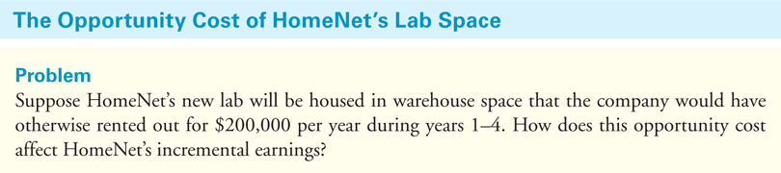
Textbook Example 8.2

Slide 15
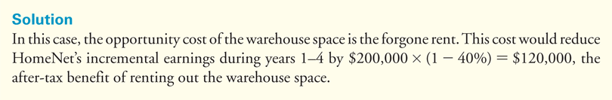
Textbook Example 8.2 (cont'd)

Slide 16
Indirect Effects on Incremental Earnings (cont'd)
Project Externalities
Indirect effects of the project that may affect the profits of other business activities of the firm. Cannibalization is when sales of a new product displaces sales of an existing product.

Slide 17
Indirect Effects on Incremental Earnings (cont'd)
Project Externalities
In the HomeNet project example, 25% of sales come from customers who would have purchased an existing Linksys wireless router if HomeNet were not available. Because this reduction in sales of the existing wireless router is a consequence of the decision to develop HomeNet, we must include it when calculating HomeNet’s incremental earnings.

Slide 18
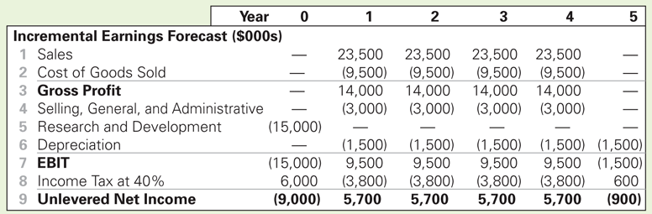
Indirect Effects on Incremental Earnings (cont'd)
Table 8.2 Spreadsheet HomeNet’s Incremental Earnings Forecast Including Cannibalization and Lost Rent

Slide 19
Sunk Costs and Incremental Earnings
Sunk costs are costs that have been or will be paid regardless of the decision whether or not the investment is undertaken.
Sunk costs should not be included in the incremental earnings analysis.

Slide 20
Sunk Costs and Incremental Earnings (cont'd)
Fixed Overhead Expenses
Typically overhead costs are fixed and not incremental to the project and should not be included in the calculation of incremental earnings.

Slide 21
Sunk Costs and Incremental Earnings (cont'd)
Past Research and Development Expenditures
Money that has already been spent on R&D is a sunk cost and therefore irrelevant. The decision to continue or abandon a project should be based only on the incremental costs and benefits of the product going forward.

Slide 22
Sunk Costs and Incremental Earnings (cont'd)
Unavoidable Competitive Effects
When developing a new product, firms may be concerned about the cannibalization of existing products.
However, if sales are likely to decline in any case as a result of new products introduced by competitors, then these lost sales should be considered a sunk cost.

Slide 23
Real-World Complexities
Typically,
sales will change from year to year.
the average selling price will vary over time.
the average cost per unit will change over time.

Slide 24
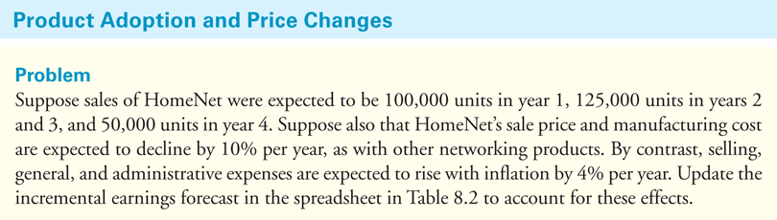
Textbook Example 8.3

Slide 25
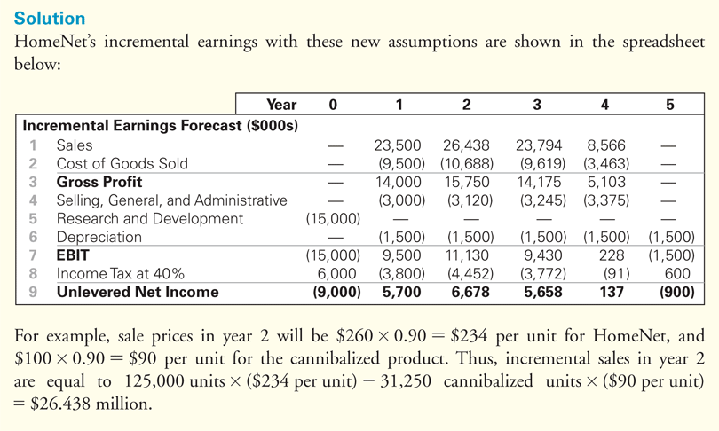
Textbook Example 8.3 (cont'd)

Slide 26
8.2 Determining Free Cash Flow and NPV
The incremental effect of a project on a firm’s available cash is its free cash flow.

Slide 27
Calculating the Free Cash Flow from Earnings
Capital Expenditures and Depreciation
Capital Expenditures are the actual cash outflows when an asset is purchased. These cash outflows are included in calculating free cash flow.
Depreciation is a non-cash expense. The free cash flow estimate is adjusted for this non-cash expense.

Slide 28
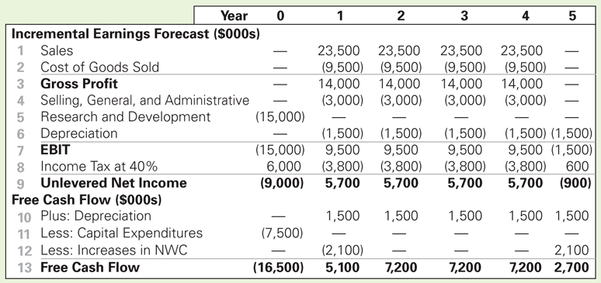
Calculating the Free Cash Flow from Earnings (cont'd)
Capital Expenditures and Depreciation
Table 8.3 Spreadsheet Calculation of HomeNet’s Free Cash Flow (Including Cannibalization and Lost Rent)

Slide 29
Calculating the Free Cash Flow from Earnings (cont'd)
Net Working Capital (NWC)
Most projects will require an investment in net working capital.
Trade credit is the difference between receivables and payables.
The increase in net working capital is defined as

Slide 30
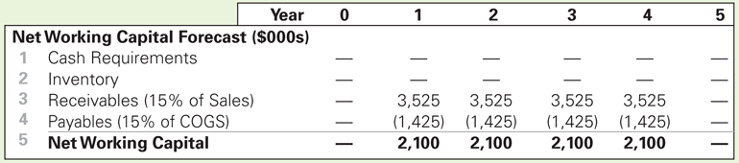
Calculating the Free Cash Flow from Earnings (cont'd)
Table 8.4 Spreadsheet HomeNet’s Net Working Capital Requirements

Slide 31
Calculating Free Cash Flow Directly
Free Cash Flow
The term τ_{c} × Depreciation is called the depreciation tax shield.

Slide 32
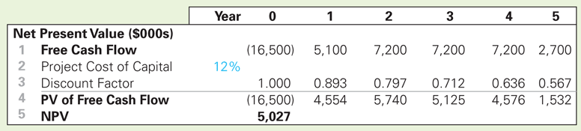
Calculating the NPV
HomeNet NPV (WACC = 12%)
Table 8.5 Spreadsheet Computing HomeNet’s NPV

Slide 33
8.3 Choosing Among Alternatives
Launching the HomeNet project produces a positive NPV, while not launching the project produces a 0 NPV.

Slide 34
8.3 Choosing Among Alternatives (cont'd)
Evaluating Manufacturing Alternatives
In the HomeNet example, assume the company could produce each unit in-house for $95 if it spends $5 million upfront to change the assembly facility (versus $110 per unit if outsourced). The in-house manufacturing method would also require an additional investment in inventory equal to one month’s worth of production.

Slide 35
8.3 Choosing Among Alternatives (cont'd)
Evaluating Manufacturing Alternatives
Outsource
Cost per unit = $110
Investment in A/P = 15% of COGS
COGS = 100,000 units × $110 = $11 million
Investment in A/P = 15% × $11 million = $1.65 million
ΔNWC = –$1.65 million in Year 1 and will increase by $1.65 million in Year 5
NWC falls since this A/P is financed by suppliers

Slide 36
8.3 Choosing Among Alternatives (cont'd)
Evaluating Manufacturing Alternatives
In-House
Cost per unit = $95
Up-front cost of $5,000,000
Investment in A/P = 15% of COGS
COGS = 100,000 units × $95 = $9.5 million
Investment in A/P = 15% × $9.5 million = $1.425 million
Investment in Inventory = $9.5 million / 12 = $0.792 million
ΔNWC in Year 1 = $0.792 million – $1.425 million = –$0.633 million
NWC will fall by $0.633 million in Year 1 and increase by $0.633 million in Year 5

Slide 37
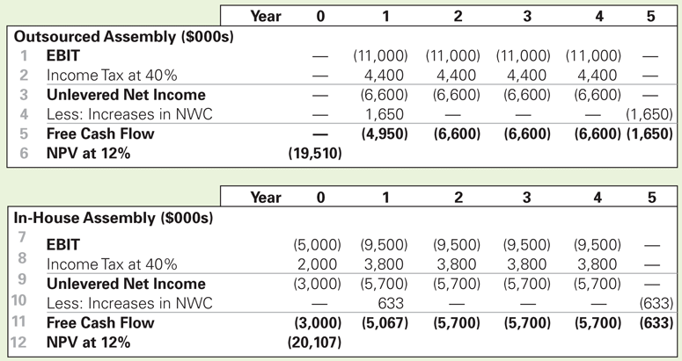
8.3 Choosing Among Alternatives (cont'd)
Evaluating Manufacturing Alternatives
Table 8.6 Spreadsheet NPV Cost of Outsourced Versus In-House Assembly of HomeNet

Slide 38
8.3 Choosing Among Alternatives (cont'd)
Comparing Free Cash Flows Cisco’s Alternatives
Outsourcing is the less expensive alternative.

Slide 39
8.4 Further Adjustments to Free Cash Flow
Other Non-cash Items
Amortization
Timing of Cash Flows
Cash flows are often spread throughout the year.
Accelerated Depreciation
Modified Accelerated Cost Recovery System (MACRS) depreciation

Slide 40
Further Adjustments to Free Cash Flow (cont'd)
Liquidation or Salvage Value

Slide 41
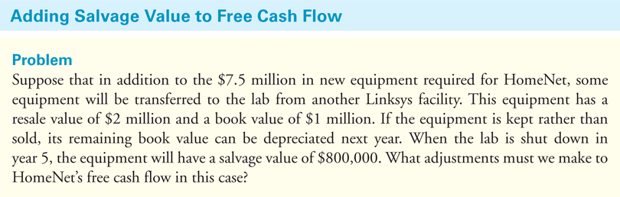
Textbook Example 8.6

Slide 42
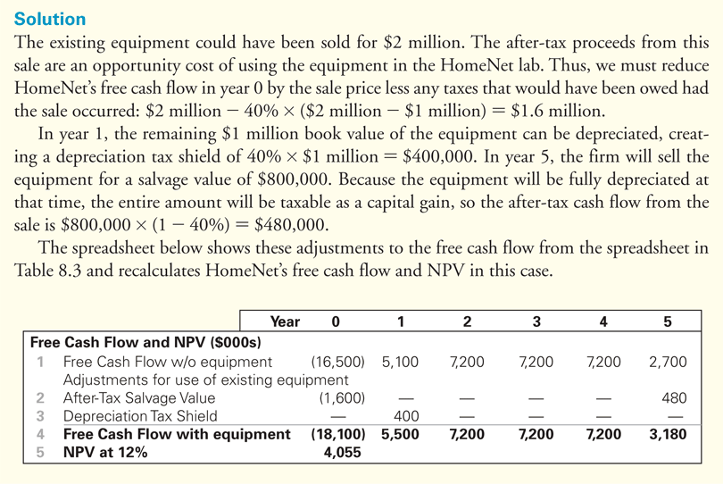
Textbook Example 8.6 (cont'd)

Slide 43
Alternative Example 8.6 (cont’d)
Solution
If the equipment is sold, the firm receive $1 million in cash but will have to pay taxes on the gain above the book value, or $1 million - $200,000 = $800,000.
The taxes due on the sale will be $800,000 x 34% = $272,000.
Thus, the firm’s free cash flow will increase by $1,000,000 - $272,000 = $728,000 for the year.

Slide 44
Further Adjustments to Free Cash Flow (cont'd)
Terminal or Continuation Value
This amount represents the market value of the free cash flow from the project at all future dates.

Slide 45
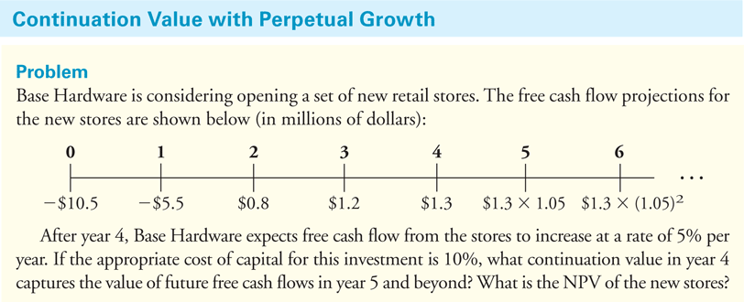
Textbook Example 8.7

Slide 46
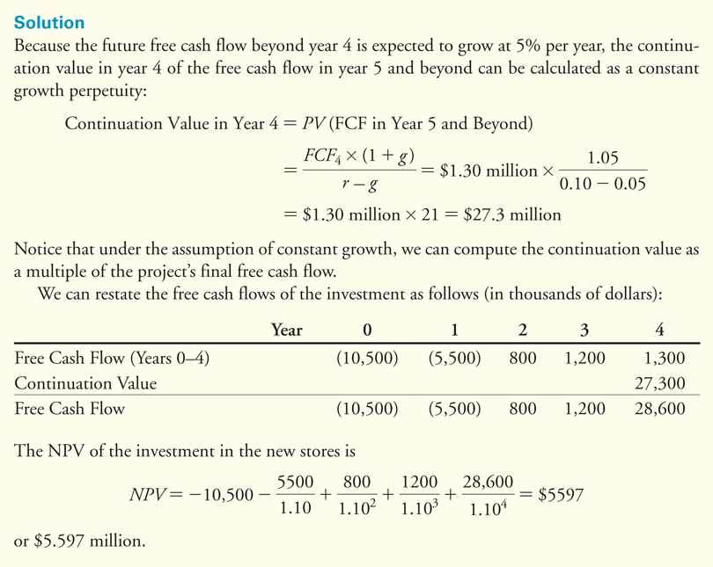
Textbook Example 8.7 (cont'd)

Slide 47
Further Adjustments to Free Cash Flow (cont'd)
Tax Carryforwards
Tax loss carryforwards and carrybacks allow corporations to take losses during its current year and offset them against gains in nearby years.

Slide 48
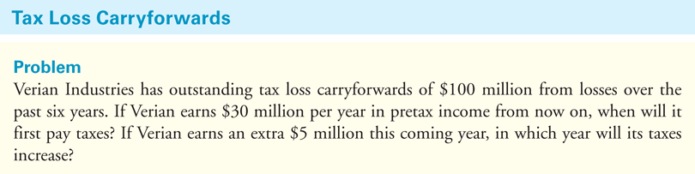
Textbook Example 8.8

Slide 49
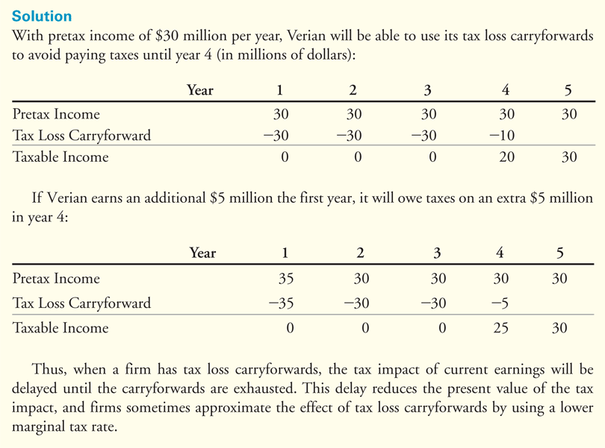
Textbook Example 8.8 (cont'd)

Slide 50
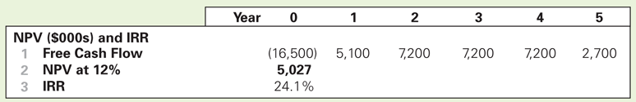
8.5 Analyzing the Project
Break-Even Analysis
The break-even level of an input is the level that causes the NPV of the investment to equal zero.
HomeNet IRR Calculation
Table 8.7 Spreadsheet HomeNet IRR Calculation

Slide 51
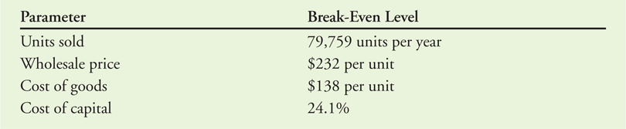
8.5 Analyzing the Project (cont'd)
Break-Even Analysis
Break-Even Levels for HomeNet
EBIT Break-Even of Sales
Level of sales where EBIT equals zero
Table 8.8 Break-Even Levels for HomeNet

Slide 52
Sensitivity Analysis
Sensitivity Analysis shows how the NPV varies with a change in one of the assumptions, holding the other assumptions constant.

Slide 53
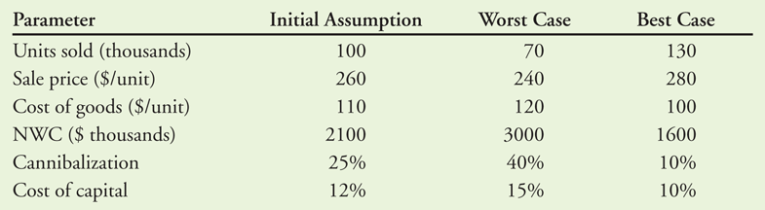
Sensitivity Analysis (cont'd)
Table 8.9 Best- and Worst-Case Parameter Assumptions
for HomeNet

Slide 54
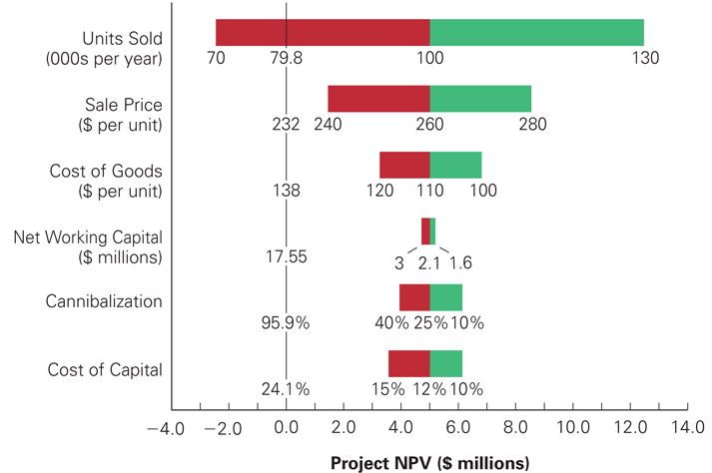
Figure 8.1 HomeNet’s NPV Under Best- and Worst-Case Parameter Assumptions

Slide 55
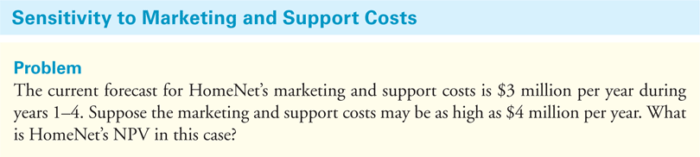
Textbook Example 8.9

Slide 56
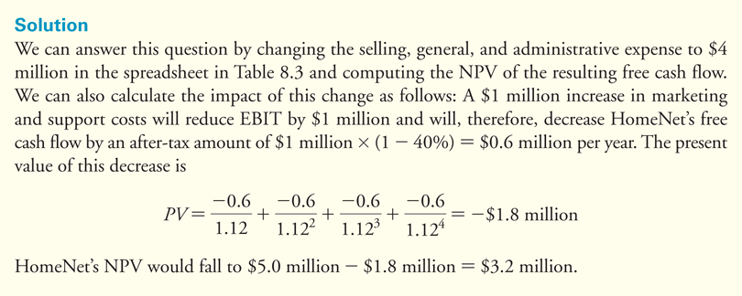
Textbook Example 8.9 (cont'd)

Slide 57
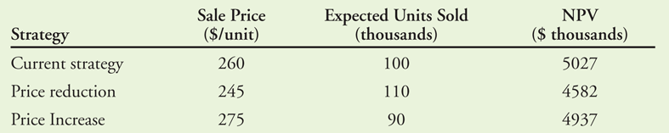
Scenario Analysis
Scenario Analysis considers the effect on the NPV of simultaneously changing multiple assumptions.
Table 8.10 Scenario Analysis of Alternative Pricing Strategies

Slide 58
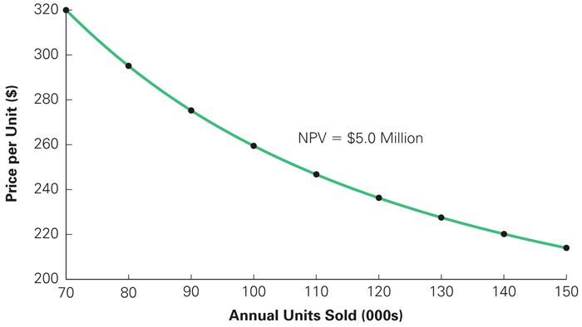
Figure 8.2 Price and Volume Combinations for HomeNet with Equivalent NPV

Slide 59
Chapter 8
Appendix

Slide 60
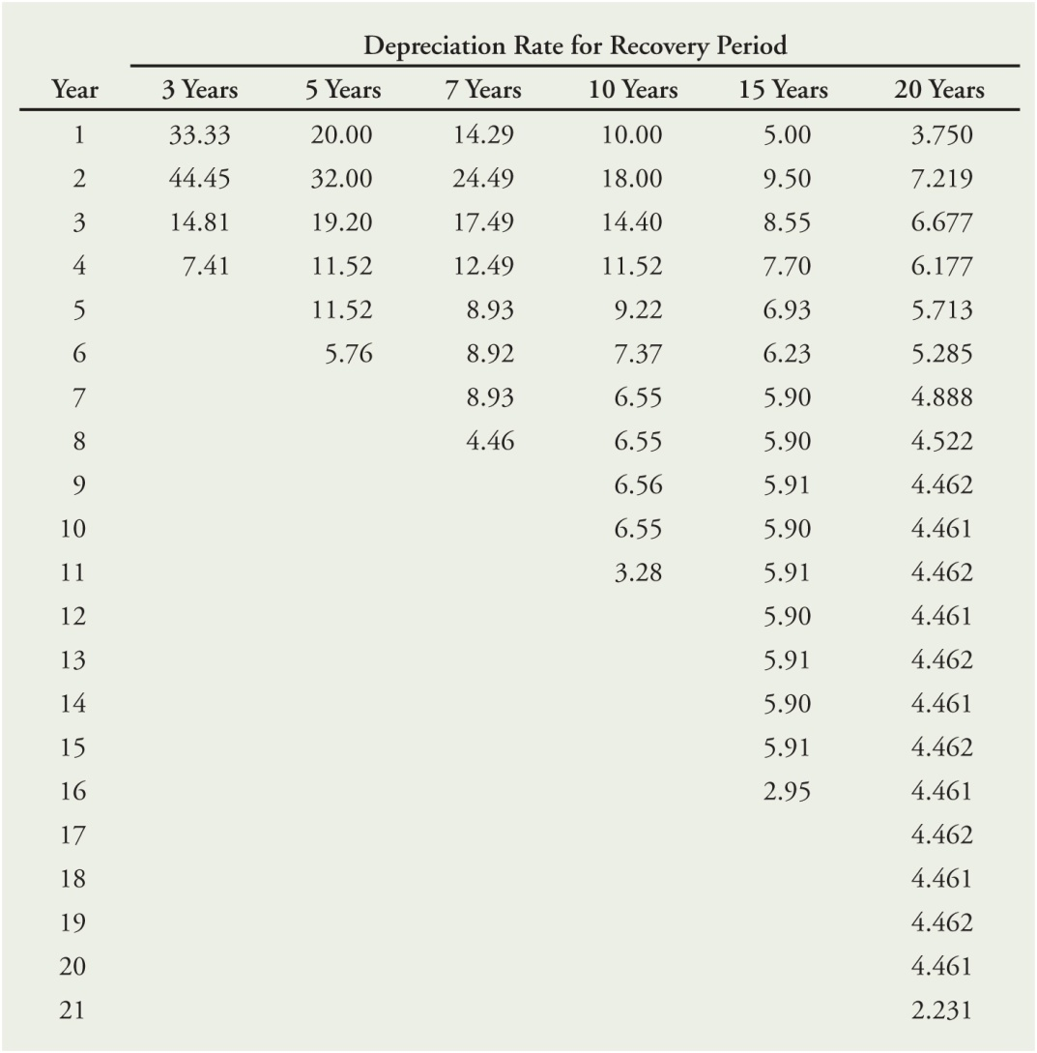
Table 8A.1 MACRS Depreciation Table Showing the Percentage of the Asset’s Cost That May Be Depreciated Each Year Based on Its Recovery Period

